Slide 1

Retirement Income
4491-11 Income - Retirement Income v11.0 VO.pptx
Form 1040 Lines 15-16
Pub 4012 Tab 2
Pub 17 Chapters 10, 17

Slide 2
Types Of Retirement Income
Pension
Annuity/Insurance Contracts
Social Security (Covered in another section)
Railroad Retirement– Tier 1 and Tier 2
IRA
401K, 403B, 457

Slide 3
Kinds of Report Forms
See 4012 Tab 2
1099-R | Pensions, Annuities, Retirement Plans, Insurance Contracts
CSA-1099R | Civil Service Retirement System (CSRS) and Federal Employees Retirement System (FERS)
SSA-1099 | Social Security Payments
RRB-1099 | Social Security Equivalent or Tier 1
RRB-1099-R | Non-Social Security Equivalent or Tier 2

Slide 4
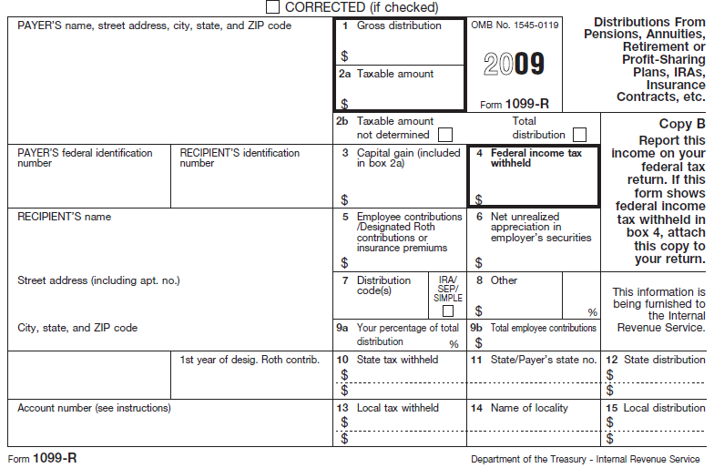
Form 1099-R

Slide 5
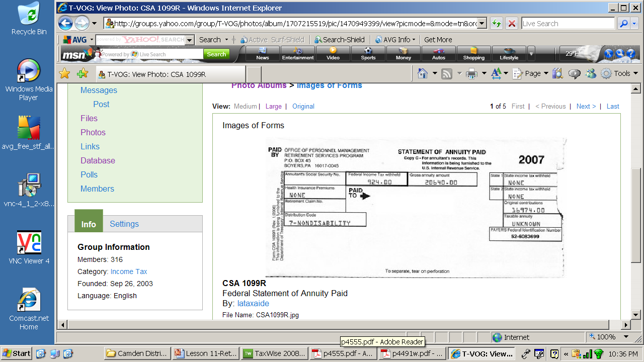
Form CSA 1099R

Slide 6
Data entry
Enter data from Form 1099-R on TaxWise 1099R worksheet
Distribution Code (Box 7) identifies type and taxability of income (pension, IRA withdrawal, rollover)
  Check box if IRA
Pub 4012: Page 2-17
Pub 4012: Page 2-18

Slide 7
Taxability Of Proceeds
TP paid none of the cost | Fully taxable
All contributions made with “before tax” dollars | Fully taxable
Cost paid with “after tax” dollars | Return of cost not taxed
Taxable amount not determined | Simplified Method- IN SCOPE General Rule-OUT OF SCOPE
LEVEL 2 TOPIC

Slide 8
Disability Income Form
1099-R, Box 2 shows taxable amount
1099-R, Code 3 in Box 7 indicates disability
  Before TP has reached minimum retirement age (as defined by employer), income is reported as wages on line 7. In TaxWise, check box below Box 7 on 1099-R so payment is included as wages on line 7
  After TP reaches minimum retirement age, income is reported as taxable pension

Slide 9
Distributions
Taxability of distributions computed separately for each 1099-R
Lump sum distribution
  Shown to right of Box 2 of Tax Wise Form 1099-R
Employee contribution in Box 5 of 1099-R – amount reported here is not taxable
Military pensions (not taxable by NJ)
  Only if DFAS (Defense Finance and Accounting Service)
  On 1099-R, check “Box 2” opposite boxes 10 & 13 – takes income out of NJ

Slide 10
Partially Taxable Distribution
Simplified Rule
Used to determine non-taxable portion of pension – Employee after tax contribution divided by total number of expected payments
Compute on Tax Wise 1099-R Exclusion Worksheet/Simplified General Rule
TP needs to know:
  Annuity starting date and TP contribution to Plan
  Prior year cumulative tax free amount if annuity started after 1986. If not available, assume $0.00
Pre-1987 starting date - tax exclusion can exceed cost and is available each year
Post 1987 starting date- tax exclusion is limited to cost

Slide 11
Pension Distribution
Special Case
Taxpayer dies while still employed
Spouse survives –receives survivor benefits from pension of deceased TP
Must use spouse date of birth and date when spouse started receiving benefit in Simplified Method

Slide 12
Problem
George age 65 started receiving pension income on January 1, 2011. His wife is 66.
  He contributed $26,000 to a qualified plan.
  He received monthly pension of $1,000.
  It is a joint and survivor annuity
See following slides for how to complete the Simplified Method worksheet to determine George’s taxable amount.

Slide 13
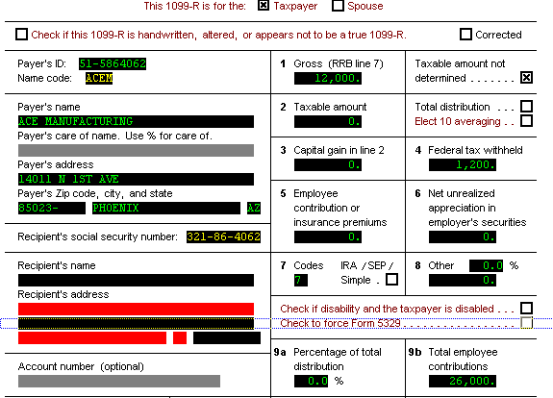
1099R: TaxWise Computation
Notes:
13
On Taxwise, replicate the 1099R

Slide 14
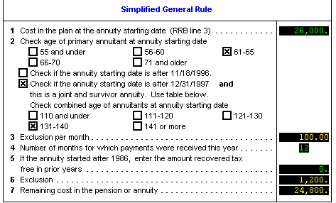

Line 1
Line 2
Tax Wise calculates Exclusion based upon cost line 1 and expected payments from line 2
Form 1040 Page 1
Notes:
14
Once lower portion of 1099-R is completed, do not go back to Line 2 and make an entry.

Slide 15
Problem Extra Credit
How much will need to be entered in box 5 of the Simplified General Rule calculation for George next year?
  Answer: $1,200 (Note: TaxWise will carry this forward automatically)
Will the amount in box 6 vary from year to year?
  Answer: No

Slide 16
Railroad Benefits
Tier 2 Benefits (Pension)
Railroad Retirement Tier 2 (Pub 575)
  RRB-1099-R - Green Form
  Same Rules as Pension Plans
Use Pub 4012 Tab 2 for instructions where to enter data in Tax Wise
RRB-1099-R Pension (not taxable by NJ)
  On 1099-R Tax Wise Worksheet, put check in “Railroad Retirement” box opposite boxes 10 & 13 – takes income out of NJ

Slide 17
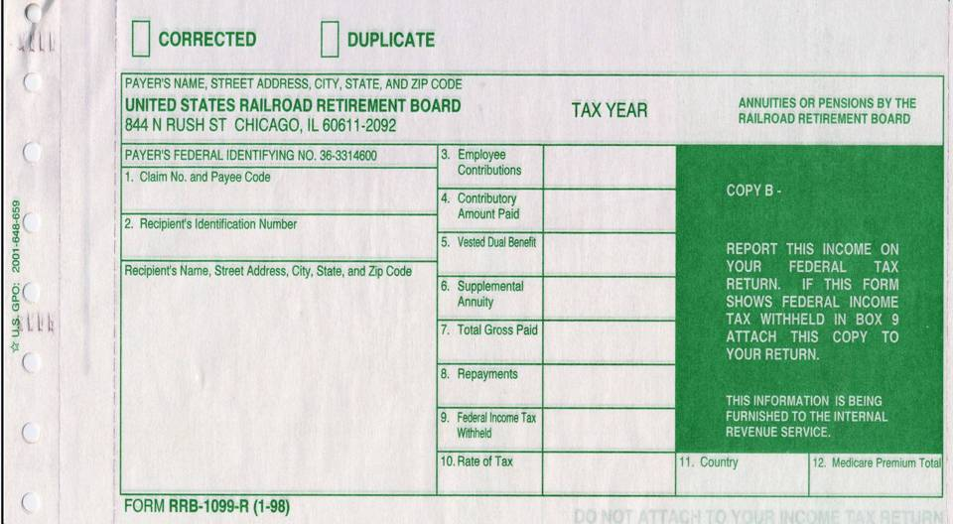
Railroad Retirement (RR) Benefits Tier 2
1040, Line 16A

Slide 18
IRAs –
Individual Retirement Arrangements
Personal savings plan for retirement
  Traditional IRA
  Nondeductible IRA
  Roth IRA
Notes:
18
8606 – competed and attached to return if TP received distribution from traditional IRA and has ever made a nondeductible contribution to any traditional IRAs.
TP cannot withdraw only nondeductible contributions.

Slide 19
Traditional IRA
Contributions tax deductible in the year made
Earnings accumulate tax-deferred
Distributions taxable in the year received
Required Minimum Distribution (RMD) by April 1 following the year TP turns 70½
  If born on or before 6/30 - Take RMD by 12/31 of that year, to avoid having to take double RMD the next year.
  Amounts withdrawn from Roth IRA cannot be used to satisfy RMD
IRA Distribution requires completion of NJ IRA Worksheet – Separate worksheet for each IRA
Notes:
19
8606 – competed and attached to return if TP received distribution from traditional IRA and has ever made a nondeductible contribution to any traditional IRAs.
TP cannot withdraw only nondeductible contributions.

Slide 20
Qualified Charitable Distributions
Tax-free treatment of distributions from traditional and Roth IRAs for charitable purposes extended through Dec 2011
  Payment must be from custodian direct to charity
Qualified charitable distributions made in Jan 2011 can be treated as having been made on Dec 31, 2010, to satisfy the taxpayer’s minimum distribution requirement for 2010.
Notes:
20

Slide 21
Nondeductible IRA
Contribution taxed in the year made
Earnings accumulate tax deferred
Distributions include contribution and earnings
  Contributions not taxed on distribution
  Earnings are taxed on distribution
Non-deductible contributions and related distributions require Form 8606 – (See separate module for restrictions)

Slide 22
Roth IRA
After-tax contributions
Earnings accumulate tax-free
Distributions are not taxable
No Required Minimum Distribution (RMD)
Don’t include qualified distributions in gross income
Distribution within 5 yr qualifying period from a conversion to a Roth IRA may be subject to 10% early distribution tax
Notes:
22
8606 – competed and attached to return if TP received distribution from traditional IRA and has ever made a nondeductible contribution to any traditional IRAs.
TP cannot withdraw only nondeductible contributions.

Slide 23
Penalties
Premature distribution (prior to 59½)
  Additional tax of 10%
  Certain exemptions – Codes 2, 3 or 4 in 1099-R, Box 7 – don’t need Form 5329
  Code 1 in 1099-R, Box 7 - need Form 5329 if other exception applies (see next slide)
  TaxWise calculates any penalty, per 1099-R input, and carries to line 60, “Other Tax” section of Form 1040
Excess contributions
  Additional tax of 6%

Slide 24
Form 5329 – Exclusions to 1099-R Code 1 Penalty
Form 5329
  Only Part I is in scope
  Must add to tree manually in TW
Sample exclusion codes (see TW help or Pub 17)
  05 – Qualified retirement plan distributions up to (1) the amount you paid for unreimbursed medical expenses during the year minus (2) 7.5% of your adjusted gross income for the year.
  08 – IRA distributions made for higher education expenses.
  09 – IRA distributions made for purchase of a first home, up to $10,000.
  12 – Other (e.g. Distributions incorrectly indicated as early distributions by code 1, J, or S in box 7 of Form 1099-R. Include on line 2 the amount you received when you were age 59½ or older.

Slide 25
401-K Plans
Before Tax Contributions (99.9% of cases)
  If any contributions were after tax (unusual) distributions are OUT OF SCOPE
Earnings accumulate tax-deferred
Distributions taxable in the year received
Required Minimum Distribution (RMD) by April 1 following the 1st year after the later of:
  Year TP turns 70½
  Year in which TP retires
Notes:
25
8606 – competed and attached to return if TP received distribution from traditional IRA and has ever made a nondeductible contribution to any traditional IRAs.
TP cannot withdraw only nondeductible contributions.

